Slide 1

Containerized Bioinformatics Ecosystem for HPC
Yucheng Zhang¹, Lev Gorenstein¹, Payas Bhutra², Ryan DeRue¹
1. Rosen Center for Advanced Computing, Purdue University, West Lafayette, IN, USA
2. Department of Computer Science, Purdue University, West Lafayette, IN, USA

Slide 2
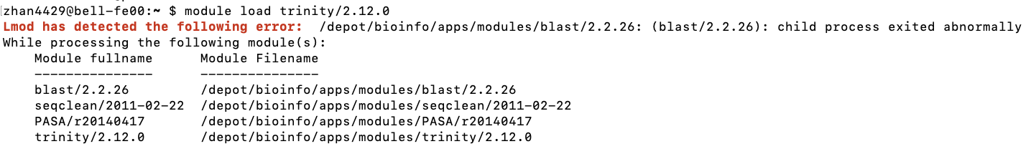
Rationale
Purdue RCAC have to manage multiple production systems, including 6 community clusters and ACCESS Anvil.
Purdue has a large number of biological researchers studying various areas, such as agriculture, ecology, animal science, health science, etc.
An easy and reliable approach to manage a large stack of bioinformatics applications is urgently needed.

Slide 3

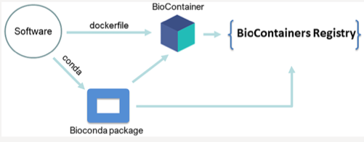
BioContainers
BioContainers is integrated with Bioconda, which is the conda channel for bioinformatics applications.
BioContainers registry is the largest registry for bioinformatics applications.
As of today, BioContainers provides containers for over 10 thousand bioinformatics applications.
J. Proteome Res. 2021, 20, 4, 2056–2061

Slide 4
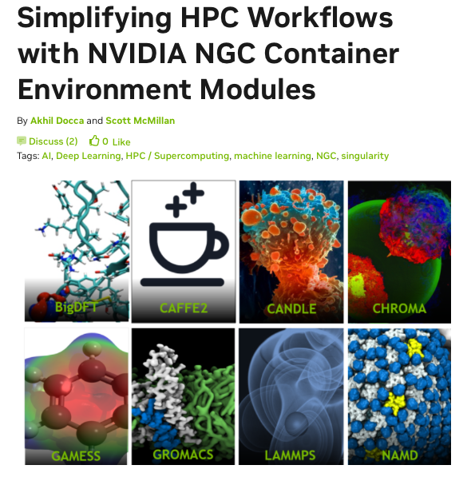
NGC container environment modules
NGC container environment modules are lightweight wrappers that make it possible to transparently use NGC containers as environment modules.
Allow HPC users to utilize familiar environment module commands.
Leverage all the benefits of containers, including portability and reproducibility.
https://github.com/NVIDIA/ngc-container-environment-modules

Slide 5
Pull/build, test before deployment
Search applications from
public registries
Failure
Build our own container images
Success
Pull container images to
one HPC production system
Generate Lmod modulefiles
Failure
Submit sbatch jobs to test containers
Success
Deploy modules to
all HPC production systems

Slide 6
Pulling images and generating Lmod modulefiles
bioc_pull2sif.sh
a wrapper around “singularity pull”
Outputing image names following the convention set by NGC container environment modules
bioc_pull2mod.sh
Generate Lmod modulefile
bioc_pull_and_module.sh
A wrapper combining the first two scripts
Given a container URI, it will pull the container image and generate its modulefile

Slide 7
Special Lmod modulefile setup
Add help/whatis information
GUI applications: bind X11 session information in ThinLinc
append_path("SINGULARITY_BIND", "/var/opt", ",")
append_path("SINGULARITY_BIND", "/run/user", ",")
Environment variables: environment variables associated with location to database or config files
pushenv("NAME", "value") ## set variable in host
pushenv("SINGULARITYENV_NAME", "value") ## set variable inside container
Adding executable path to PATH
pushenv("SINGULARITYENV_PREPEND_PATH", "/path/to/pkg/bin")
Bind paths: bind database or config files
append_path("SINGULARITY_BIND", "hostdir:containerdir", ",")

Slide 8
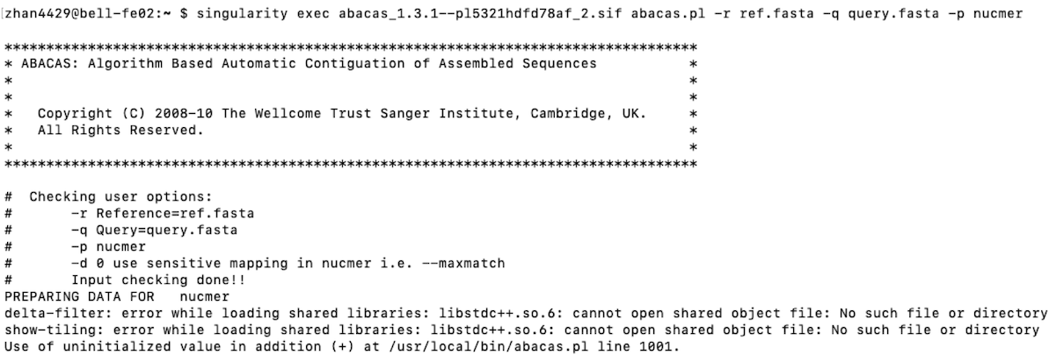
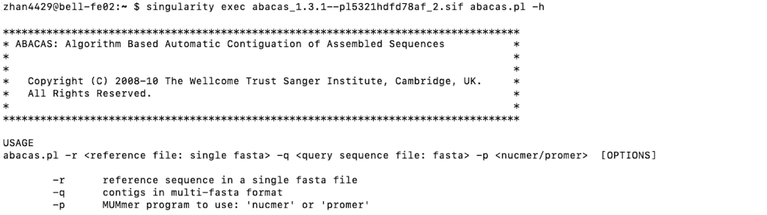
Testing modules before deployment
Help message
Missing libraries
Running analysis with real-world datasets is the only reliable way to make sure applications work as expected.

Slide 9
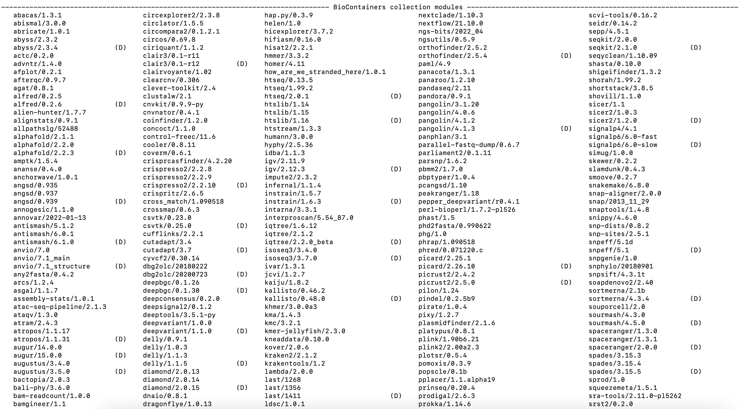
600 modules for 500 applications

Slide 10
Sources of container images

Slide 11
Bioinformatics applications on HPC
Fewer than 100: most HPC centers
~1000: clusters designed for biosciences, e.g. NIH’s Biowulf and Cornell’s BioHPC
Thousands: the whole BioContainers project in TACC’s clusters
RollingGantryCrane (https://github.com/TACC/rgc)

Slide 12
Too many is not necessary

Slide 13
Adding Jupyter support
Bootstrap: docker
From: quay.io/biocontainers/cellrank:1.5.1--pyhdfd78af_0
%labels
Author: Yucheng Zhang zhan4429@purdue.edu
Version: 1.5.1
%help
CellRank with Jupyter support.
%post
pip install ipython
pip install ipykernel
Hopefully BioContainers developers can install ipython and ipykernel into all python-based container images.

Slide 14
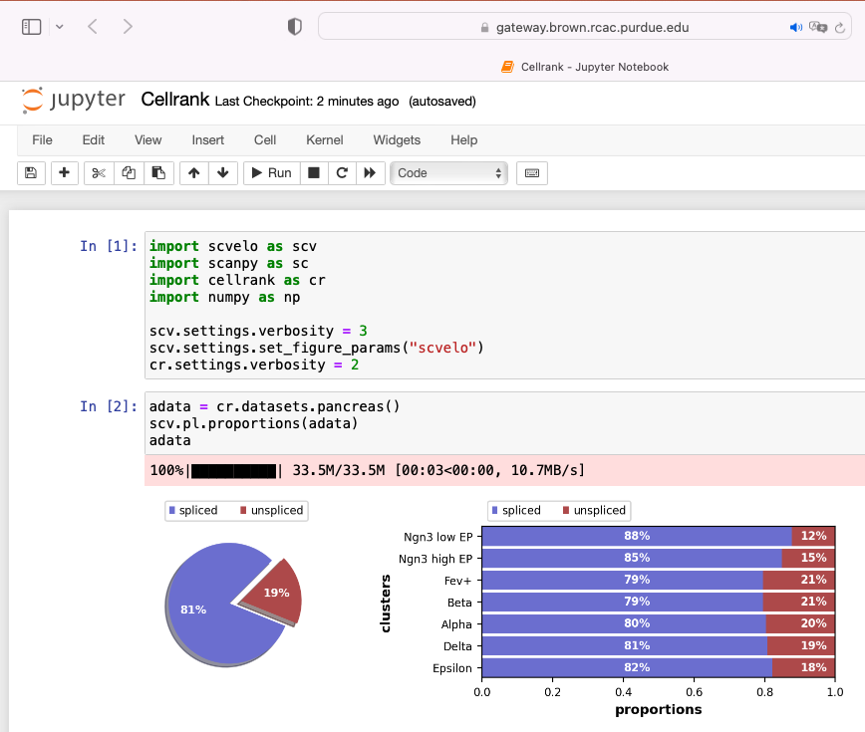
Open OnDemand Jupyter
{
"argv": [
"/usr/bin/singularity",
"exec",
"/apps/biocontainers/images/cellrank_1.5.1.sif",
"python",
"-m",
"ipykernel_launcher",
"-f",
"{connection_file}"
],
"display_name": "Cellrank",
"language": "python"
}
$HOME/.local/share/jupyter/kernels/

Slide 15



Bundle applications into a single container image
With containers, it is easy to install not just a single application, but also bundles and collections of multiple applications working in concert and dedicated to a specific research workflow.
ComplexHeatmap
DESeq2
DEXSeq
edgeR
ggrepel
Limma
pheatmap
tidyverse
CoGAPS
DESeq2
doSNOW
DropletUtils
edgeR
Limma
miQC
monocle
monocle3
Nebulosa
rliger
scCATCH
scDblFinder
SCHNAPPs
scMappR
seurat
seurat-wrappers
SingleR
SnapATAC
SoupX
tidyverse
tricycle
velocyto.R
And more

Slide 16
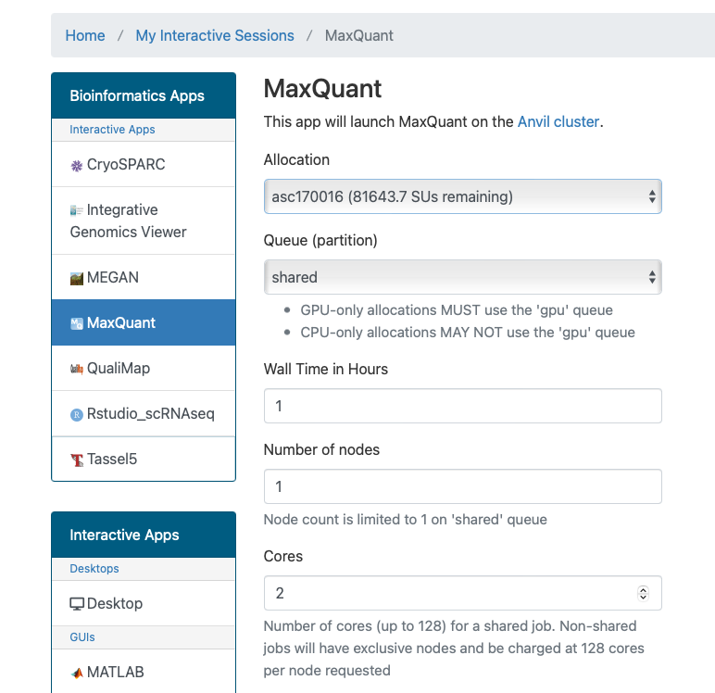
Open OnDemand
For bioinformatics applications that use a native graphics user interface (GUI) and that have a large computational or memory footprint, we employ Open OnDemand to allow users to easily allocate appropriate amount of resources and submit jobs through a convenient web interface.
We create a simple workflow for rapid deployment of containers to Open OnDemand of any cluster.
default_biocontainer_template: a template Open OnDemand application directory for a generic VNC desktop application.
deploy_biocontainer: a helper script that makes a copy of the template directory and performs the necessary substitutions to the relevant files.

Slide 17
Turning containers into OOD aps
With the template directory default_biocontainer_template and the deploy_biocontainer script, we can easily turn container images into Open OnDemand interactive applications using a one-line command:
deploy_biocontainer --name appName \
--directory folderName \
--image app.sif \
--command launchCommand \
default_biocontainer_template
ENTRY="[Desktop Entry]
Type=Application Name=IGV
Comment=
Exec=/bin/bash -lc \"singularity exec /apps/biocontainers/images/igv_2.12.3.sif igv.sh\"
Path=
Terminal=false
StartupNotify=false
Categories=Cluster"
echo -e "$ENTRY" > "${AUTOSTART}/igv.desktop"
A snippet from xfce.sh for the genomic browser IGV

Slide 18
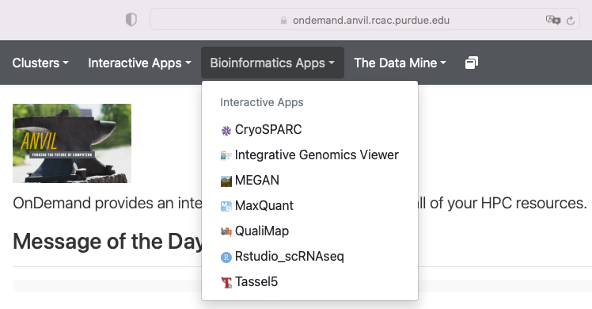
Open OnDemand Applications

Slide 19

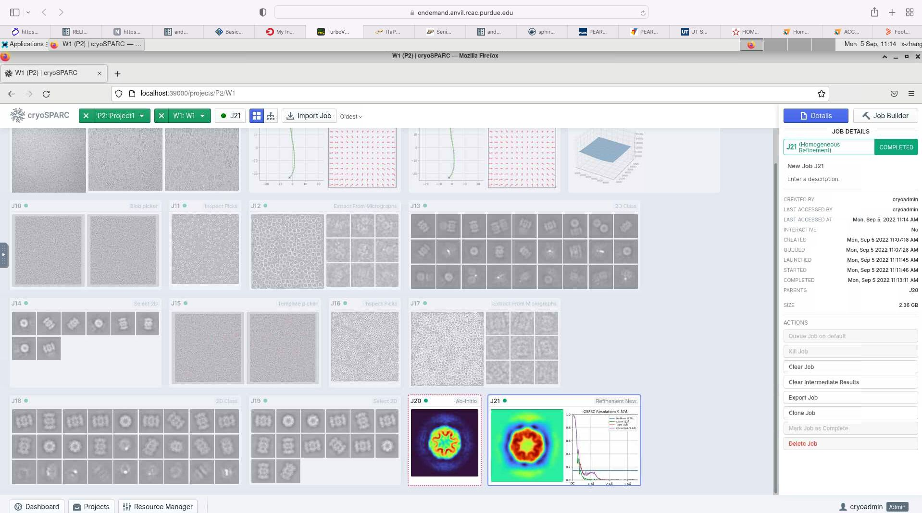


Not only bioinformatics
Thank Michael Dickens from Texas A&M University for showing us how to build and run the cryoSPARC container.

Slide 20
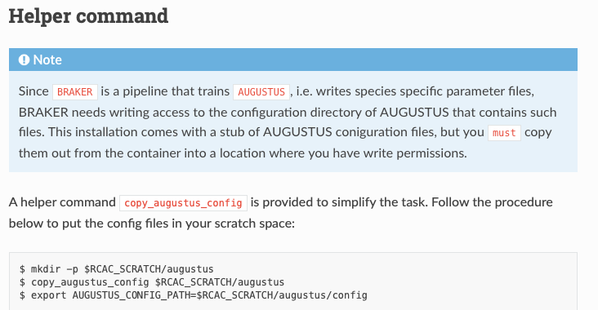
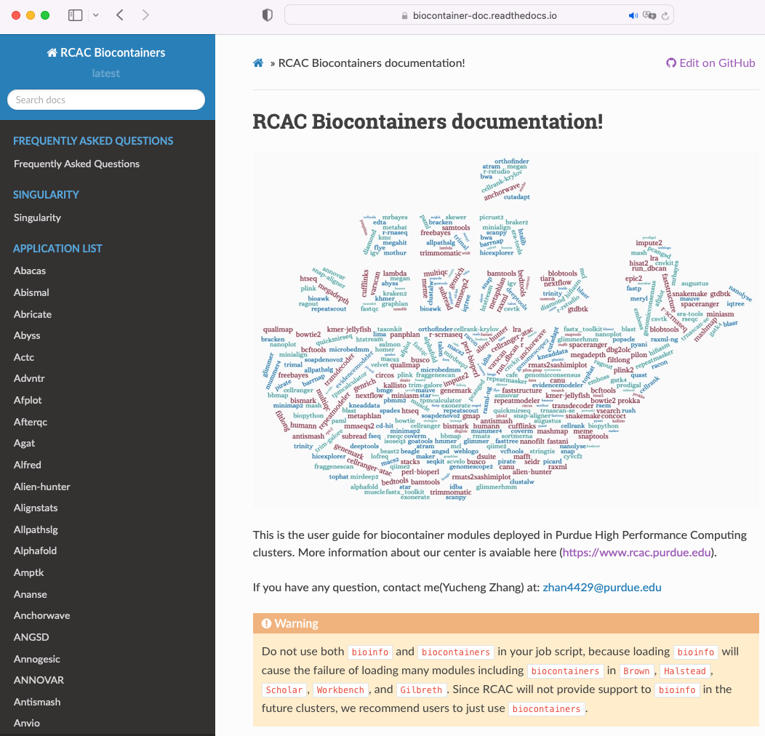
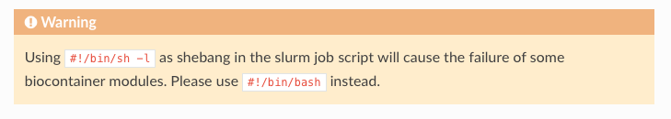
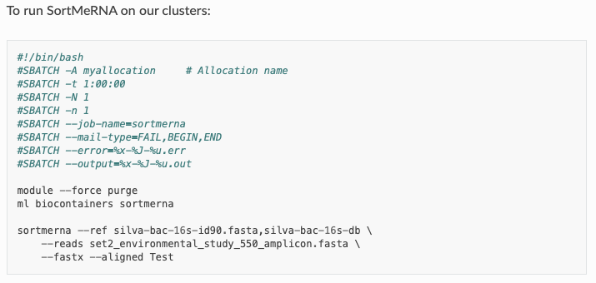
https://biocontainer-doc.readthedocs.io/en/latest/

Slide 21
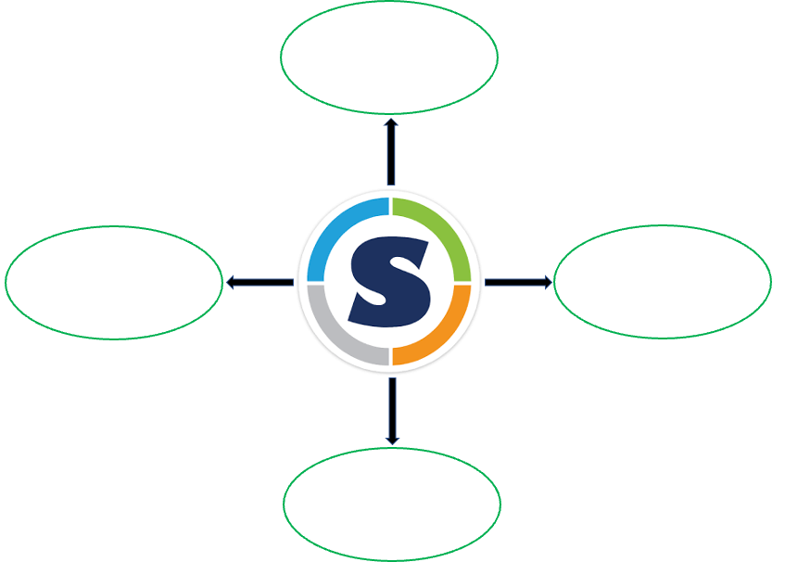
Containerized Bioinformatics Ecosystem

Slide 22
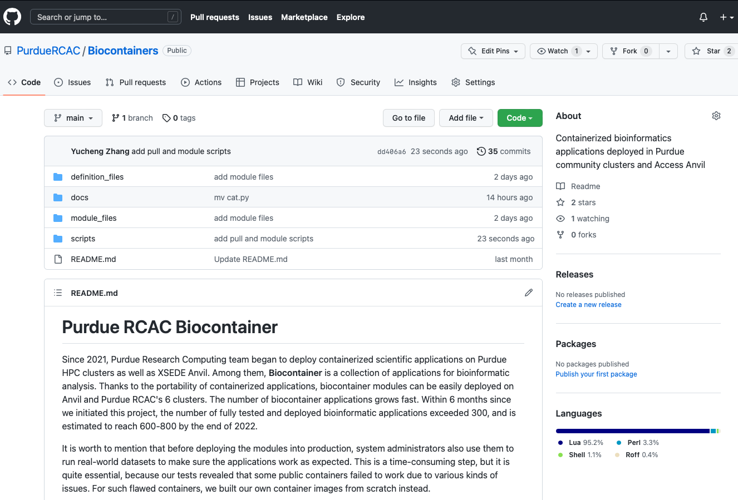
Interested in building a similar ecosystem in your center?
Contributions are welcome!
If you find issues or bugs, please open an issue in the GitHub repository.
Our goal is to improve the Biocontainer project together with all centers, and we need your ideas and input to keep on improving.
We welcome any contribution including scripts, modulefiles, definition files, etc.
git clone https://github.com/PurdueRCAC/Biocontainers.git

Slide 23
Thank you!
Contributors
Yucheng Zhang
Lev Gorenstein
Payas Bhutra
Ryan DeRue
HUST22 Committee
Purdue RCAC
Preston Smith
Xiao Zhu (Intel)
Arman Pazouki
Amiya Maji
Geoffrey Lentner
Guangzhen Jin
Sarah Rodenbeck
Steve Kelley
Yang Hong
Tsai-wei Wu
Nannan Shan
Eric Adams
Ruyi Li

